Slide 1
MSc Project
Engineering Design Optimisation – Overview of Problem
Josh Hellewell

Slide 2
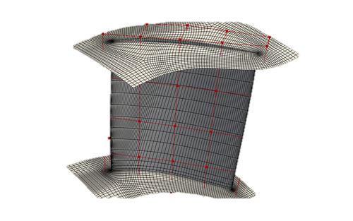
Background
Rapid design iterations are often limited by the computational expense of numerical simulations.
Simulations are often used in place of costly experimental testing.
Being able to rapidly modify designs and receive rapid feedback would enable efficient design space exploration.
The geometry of aero components can be very complex, and not easily parameterizable.
Relating performance to global changes in component features may enable targeted design optimization.
https://dafoam.github.io/mydoc_tutorials_aero_rotor37.html
Notes:
https://mark-hobbs.github.io/posts/autoencoders
https://infoscience.epfl.ch/server/api/core/bitstreams/1a8b7f4f-0155-4323-a8cb-51f6fc1e1537/content

Slide 3
Problem Landscape
CFD Solver
hrs/days/months
Geometry Import
Meshing
Simulation Setup
‘Solve’
Post-process
Solve Predictions
Solution Convergence Checks
E.g., Pressure, temperature, velocity fields.
Obtained through solving physics equations (e.g., Navier stokes).
High-dimensional input data.
Suffers from instability.
Sensitive to user decisions.
Computationally expsnsive.
Design optimization.
CAD Produced
Design engineer proposes design.
Predictions consumed.
*if significant
Notes:
https://www.dmsonline.us/cfd-workflow/

Slide 4
Aspirations
Reduce the time taken to obtain performance feedback from design changes.
Enable rapid design space exploration across the pareto front.
Extract and use and interpret features from complex geometry shapes and relate them to performance changes.

Slide 5
Approaches
Substitute costly computational methods with more efficient model approximations (surrogates).
Use existing data sources to pave the way to efficiency. Combine, and learn from existing simulation data.
Redefine the way we handle complex geometries – i.e., move away from high-dimensional mesh representations.
Represent unstructured data inputs in way that that can be more efficiently handled.

Slide 6
Challenges
Sufficient CFD simulation data is required to train surrogate, data-driven models – this is computationally expensive limiting the training of data-hungry machine learning models (NNs).
Significant compute power required to work with such large geometry datasets (100mbs per component)
CFD geometry inputs vary with geometry complexity. Approaches must be dynamic to mesh inputs.
Notes:
Streamline curvature method – Less computationally expensive https://link.springer.com/article/10.1007/s00158-023-03703-9

Slide 7
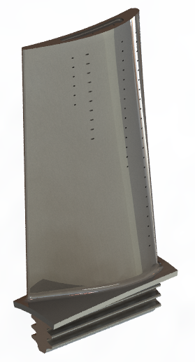
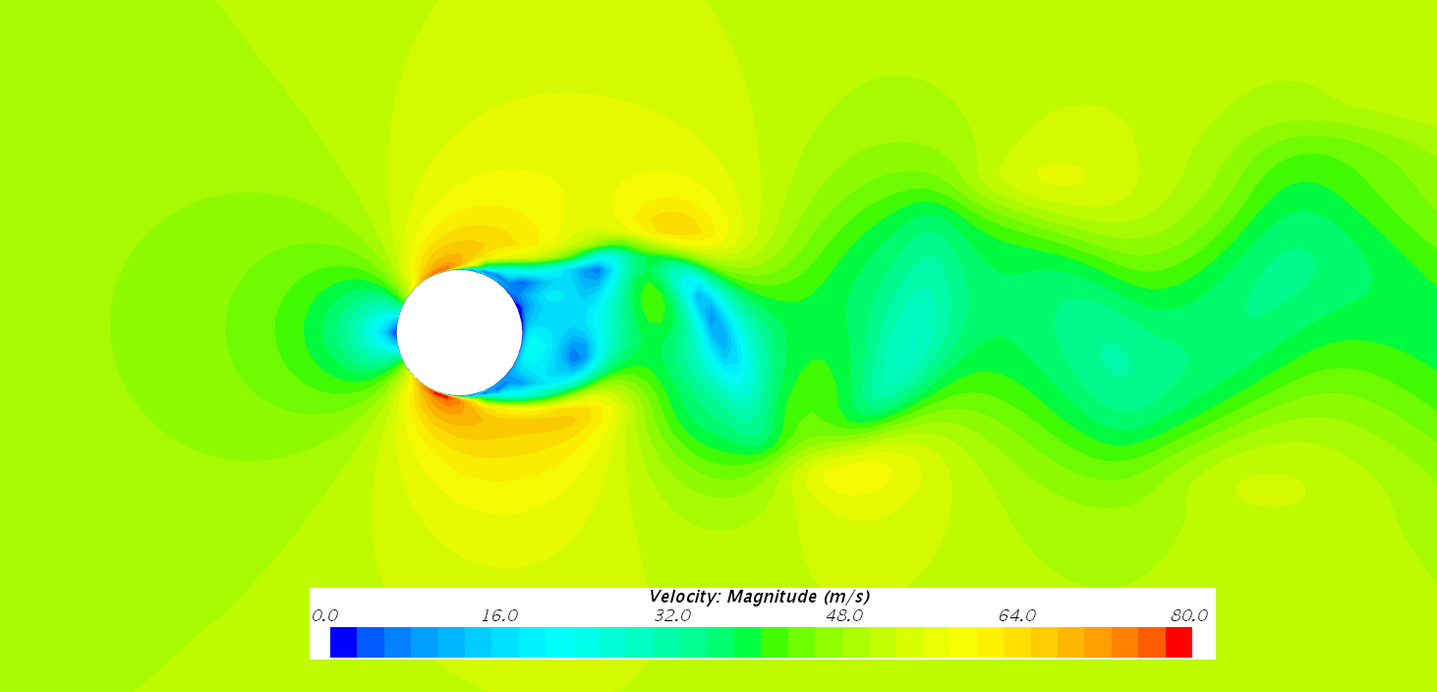
Summary
Mapping Operator
Geometry Input
Simplified Representation
Flow Variables (e.g., Pressure)
t=0
t=~minutes

